Slide 1

School of Individual Studies
Masters in Professional Studies Capstone Presentation
Fall 2016

Slide 2
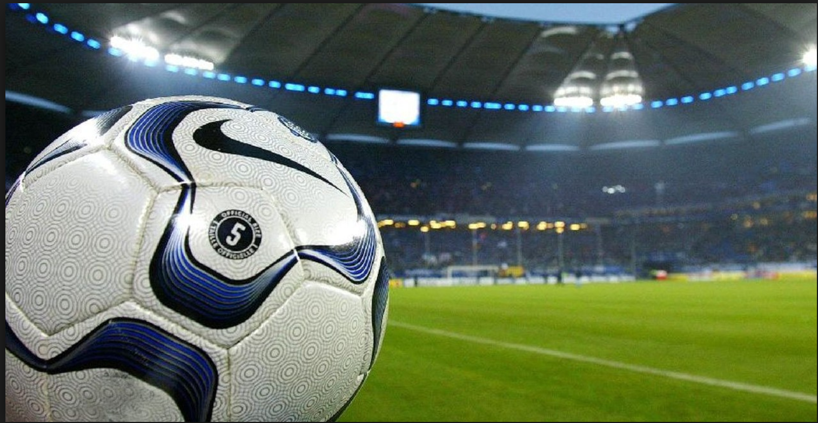
Soccer Result Analysis and Prediction

Slide 3
Presentation Outline
Personal Introduction
Problem Background
Project Objective
Data Preparation
Feature Selection
Modeling
Result Interpretation
Next Steps
Lesson Learnt
Acknowledgements
References

Slide 4
Personal Introduction
Karan Chauhan
Masters in Professional Studies with concentration in Computer Science
Specialization in Big Data Analytics
Undergraduate in Computer Engineering
Projects Including Data Analysis, NLP and Core Java
Skills : R, Java, Machine Learning, Web Development

Slide 5
Problem Background
Soccer is the most popular sport in the world.
Strategy plays a crucial role.
Can we Predict match results and future outcomes based on previous data?
Is Data Analysis and machine learning a solution?
Why this project?
Study the impact of Data Analysis on Sports Prediction.
Help Statisticians and Soccer Organizations to improvise their strategy.

Slide 6
Project Mentor
Dr. Carol Romanowski
Associate Professor in Computer Science at RIT.
Research Areas : Applied Data Mining in critical infrastructure protection and engineering design.
On the editorial board of the International Journal of Data Mining, Modeling and Management.

Slide 7
Project Objective
Apply data analysis and machine learning to predict match results, future outcomes and other important factors based on match statistics.
Study the effect of various factors in determining future match results.
Predict :
Match Results
Home and Away Team Scores
Home Win, Away Win and Draw Betting Odds
Win Percentages
Top 3 Teams in the Current League

Slide 8
Project Timeline
Week | Task
Week 1 | Domain Selection
Week 2 | Dataset Understanding
Week 3 | Data Cleaning
Week 4 | Data Preparation
Week 5 | Feature Selection
Week 6 | Regression and Classification Analysis
Week 7 | Poisson Model
Week 8 | Testing the models
Week 9 | Analyzing Results
Week 10 | Capstone Report
Week 11 and 12 | Submission and Presentation

Slide 9
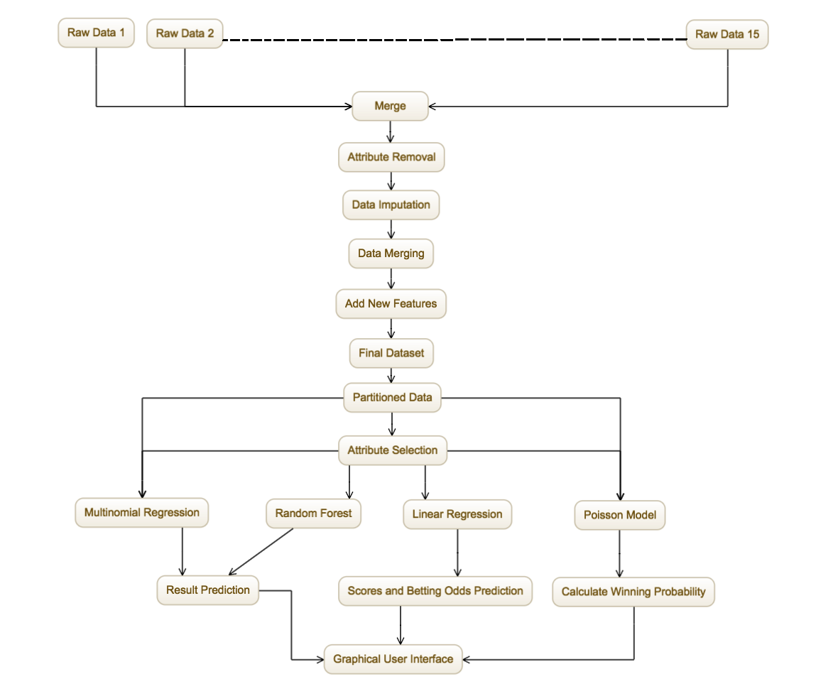
Major Actions Taken - Implementation

Slide 10
Data Description
English Premier League data from www.football-data.co.uk
15 different data files with number of attributes ranging from 48 to 75.
Attribute Description: Next slide

Slide 11
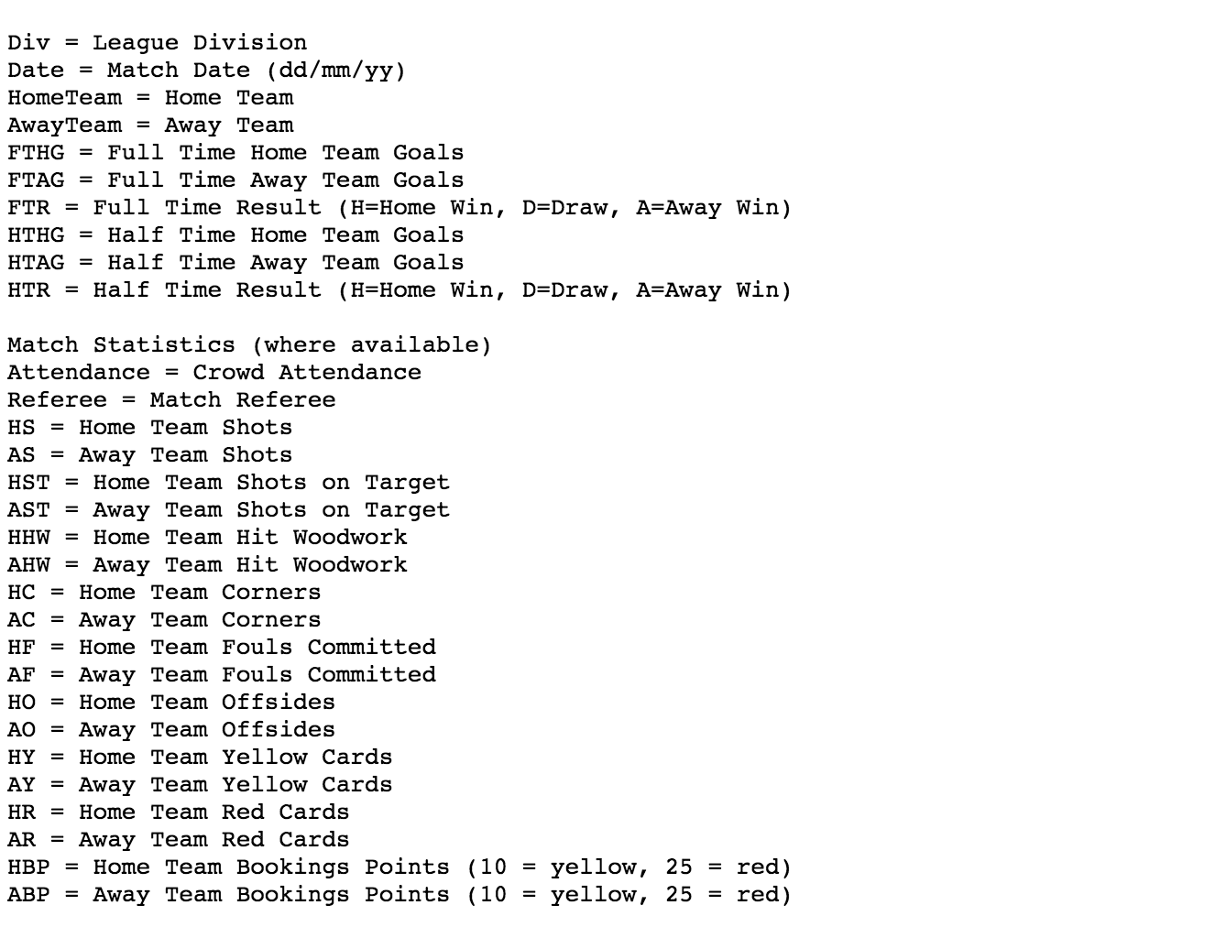
Data Description

Slide 12
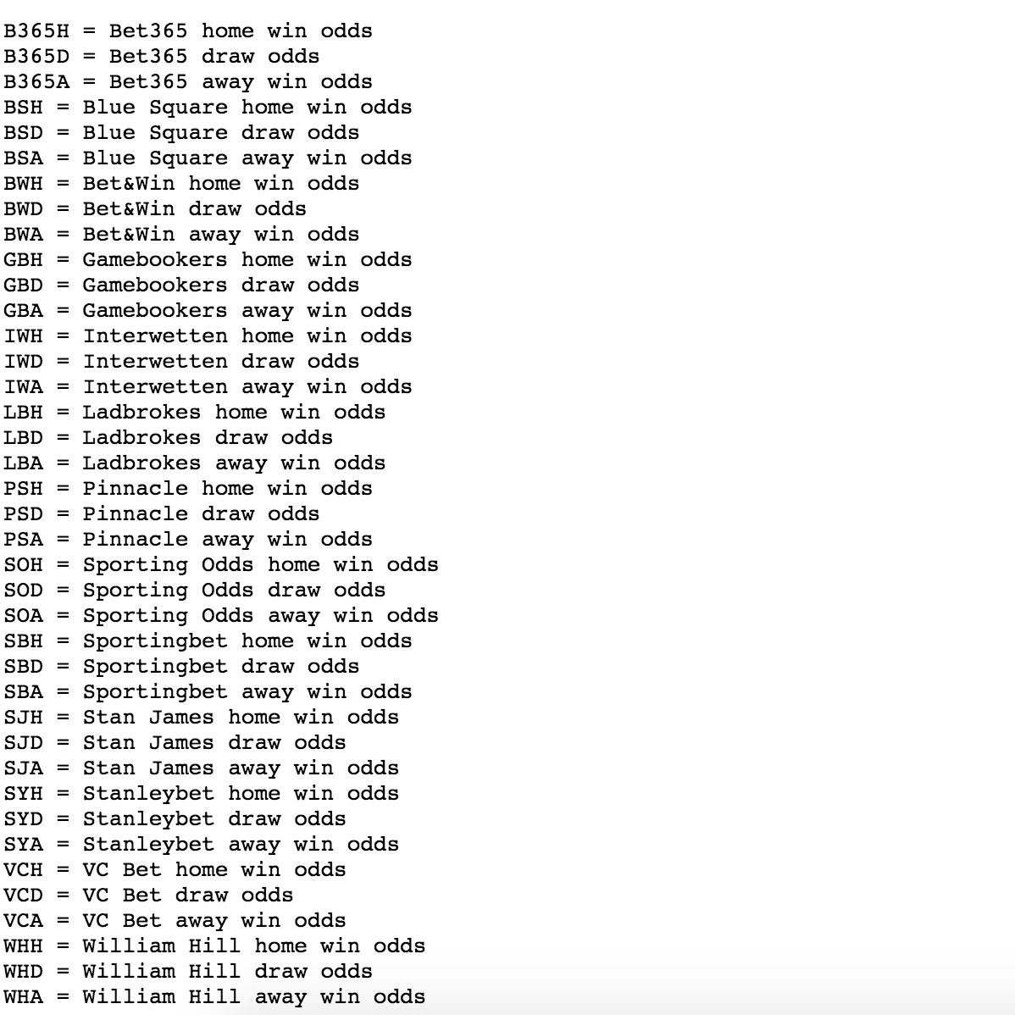
Data Description

Slide 13
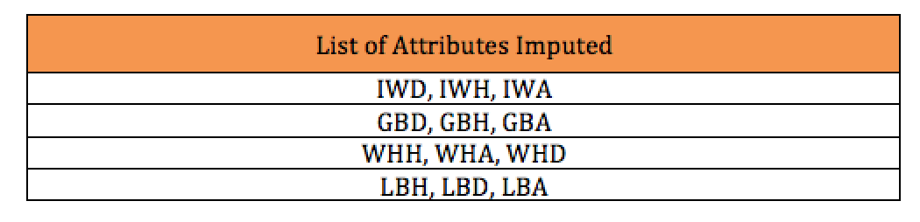
Data Preparation
Data Cleaning:
Removed attributes with majority of null values.
Removed attributes such as Referee and other betting odds data.
Data Imputation:
Replace missing values with mean of other values.

Slide 14
Data Preparation
Data Merging:
15 files were combined into 10 files based on common attributes.
Data Cleaning and Data Imputation
10 files were merged into final csv file with 56 attributes.
Additional Attributes such as HomeRF, AwayRF, HMRL and AMRL were added.
Final Dataset: 6080 instances and 60 attributes.

Slide 15
Feature Selection
Selecting the important attributes for our model.
3 feature selection techniques used:
Correlation Plots
Boruta Package
Chi-squared and InfoGain Attribute Ranking in Weka

Slide 16
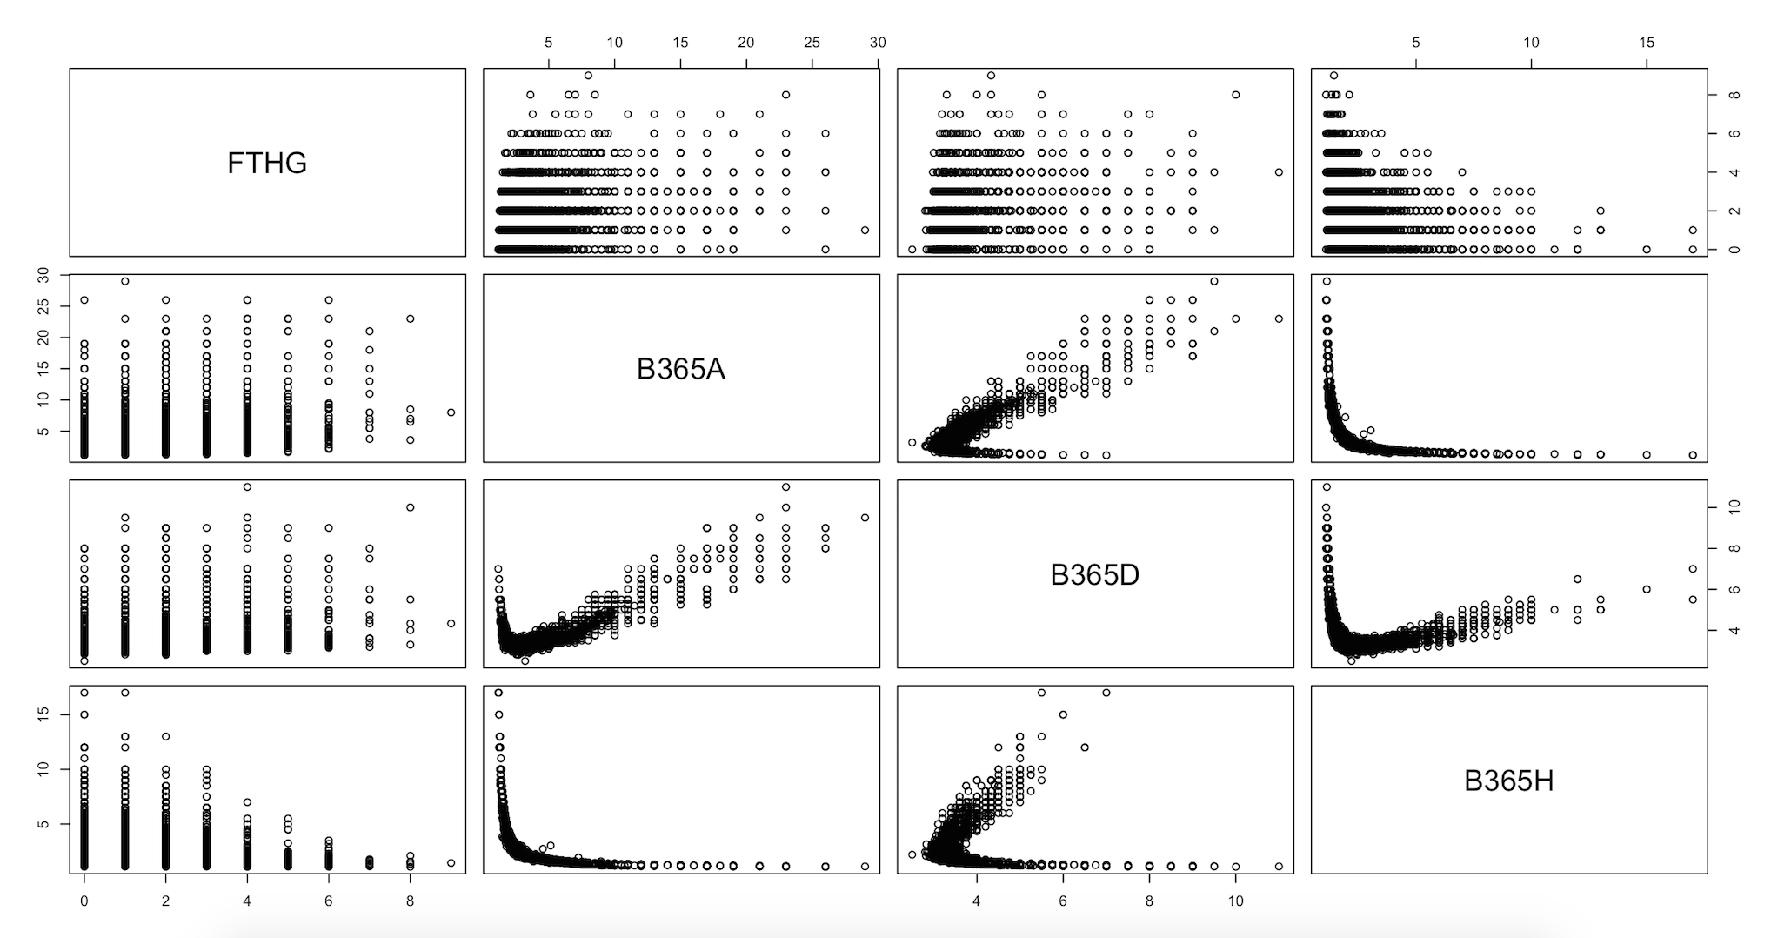
Correlation Plots –
Home Team Goals vs Betting Odds

Slide 17
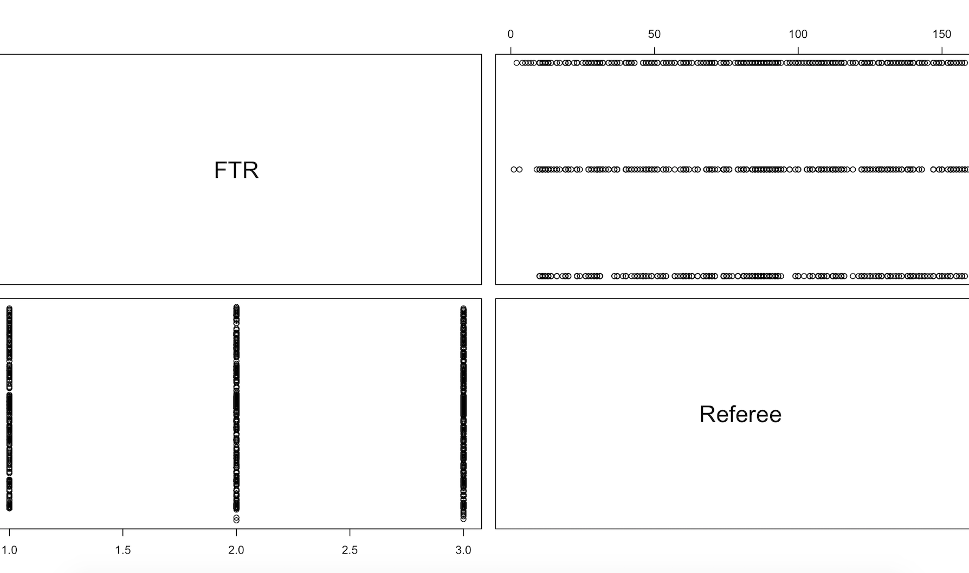
Correlation Plots –
Full Time Results vs Referee

Slide 18
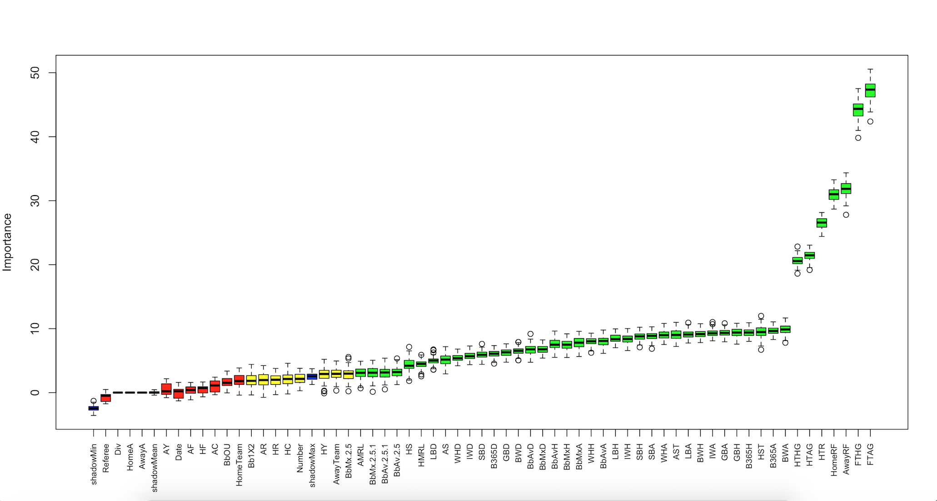
The Boruta Package
Performs multiple iterations on shuffled set of features
Compares Importance of all features

Slide 19
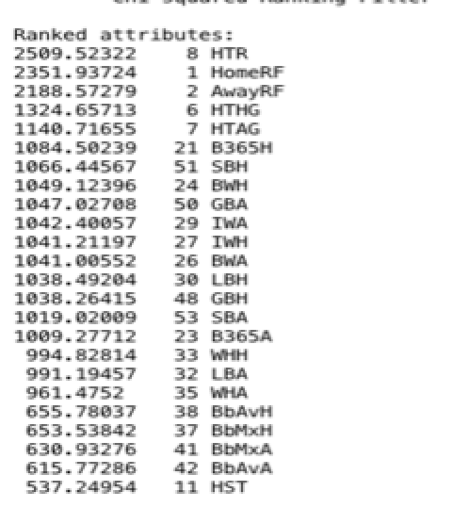
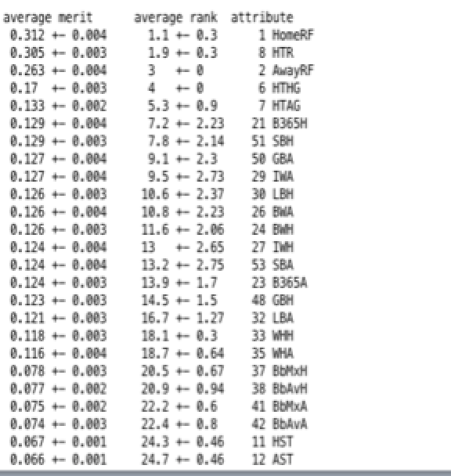
Attribute Ranking Techniques
ChiSquared and InfoGain in Weka

Slide 20
Approach
Data Partitioning: 75% training set and 25% testing set
Result Prediction: Used multinomial regression with two sets of attributes and random Forest classification.
Score Prediction and Betting Odds Prediction: Used linear regression.
Win Percentage Prediction: Used Poisson Model using probability.
Top 3 Team: Predicted top 3 teams with highest number of points in the current league season using results obtained in analysis.

Slide 21
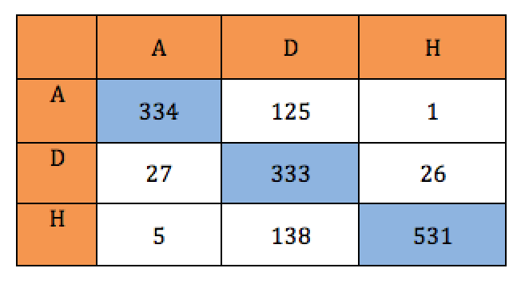
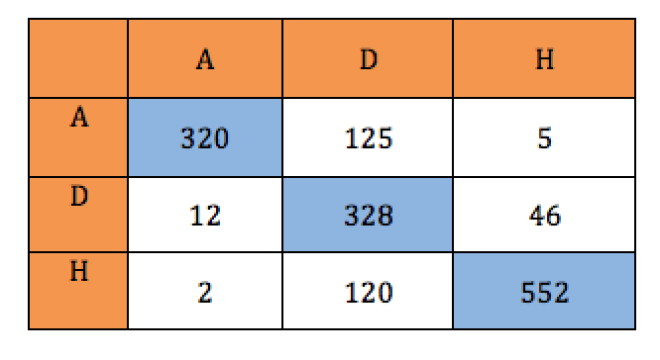
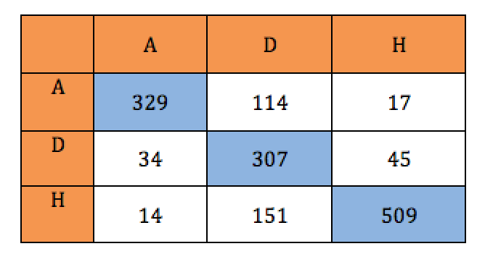
Results – Outcome Prediction
Confusion Matrix for Multinomial Regression using both the feature sets
Confusion Matrix for Random Forest Classification

Slide 22
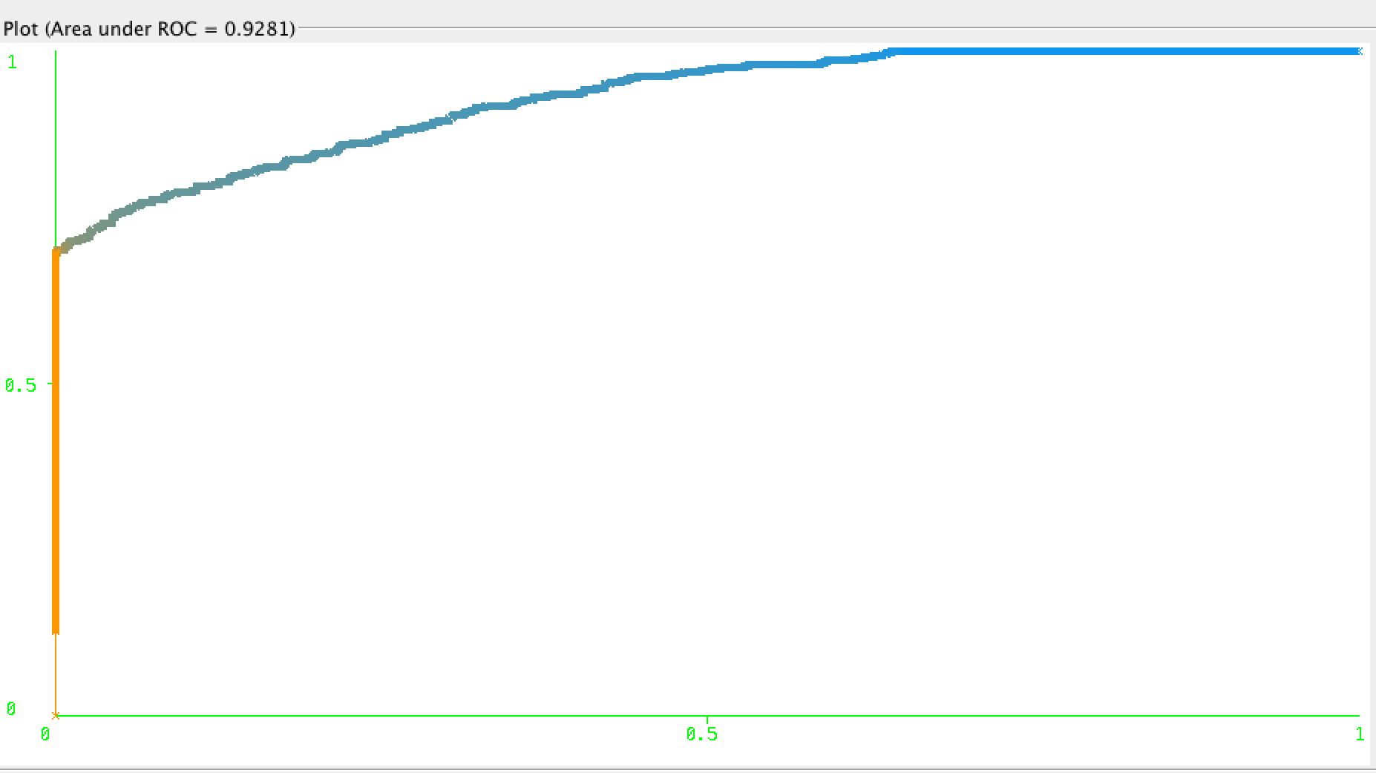
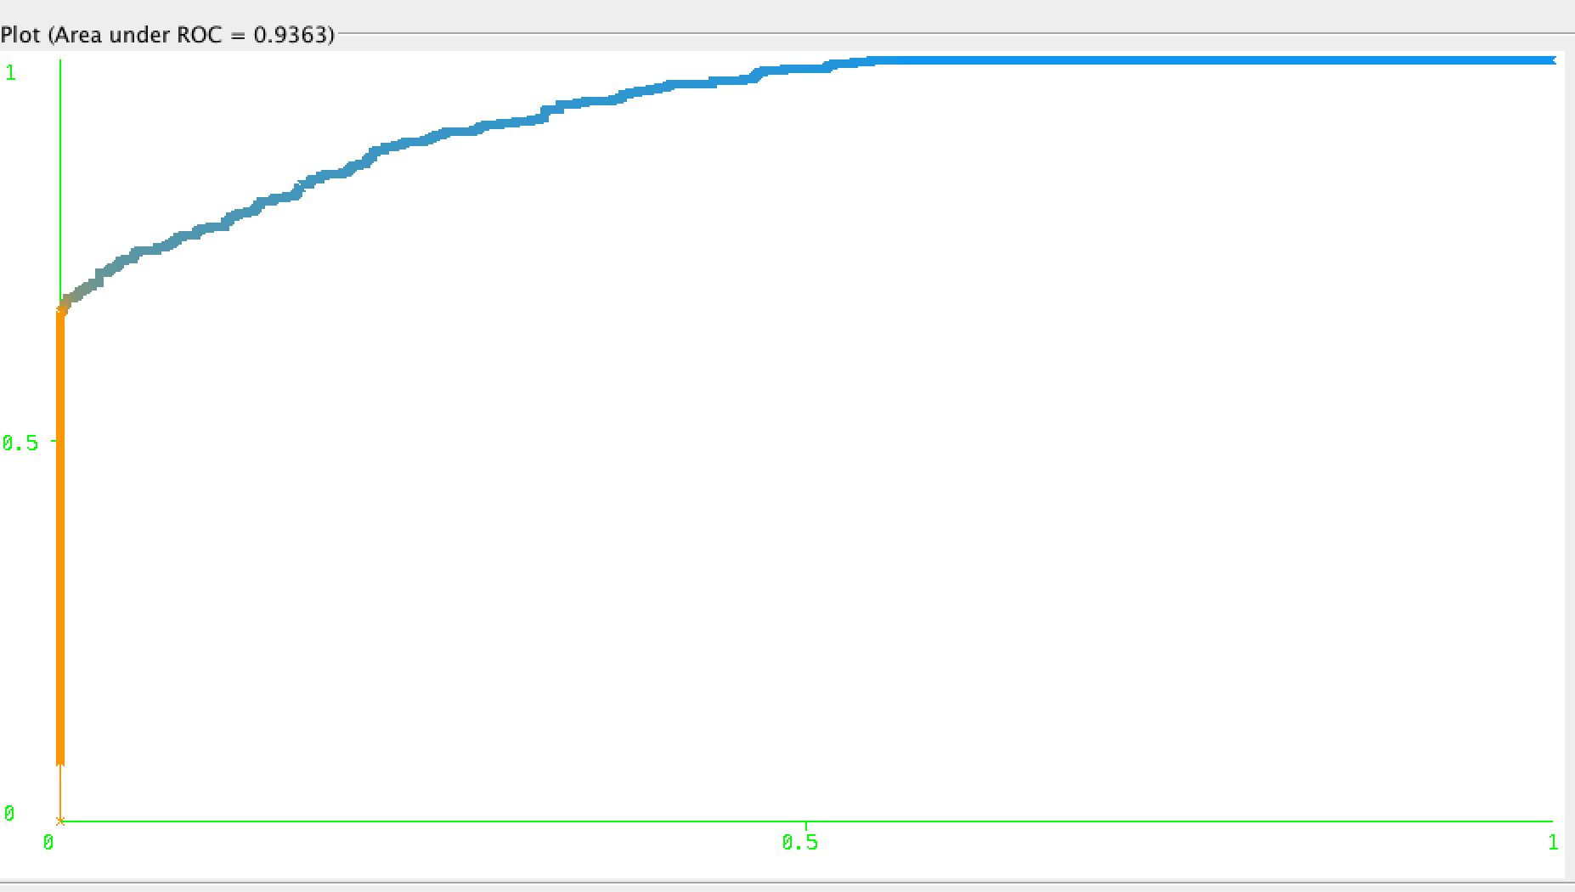
Results – Outcome Prediction
ROC curve for in favor of Home win
ROC curve for in favor of Away win

Slide 23
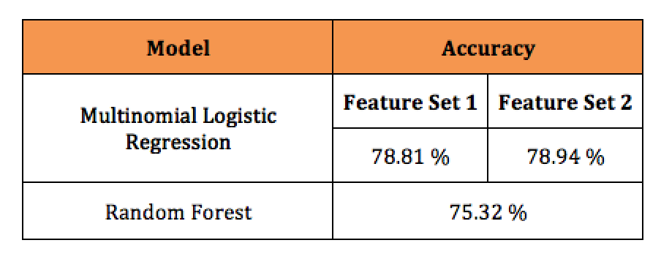
Results – Comparison

Slide 24
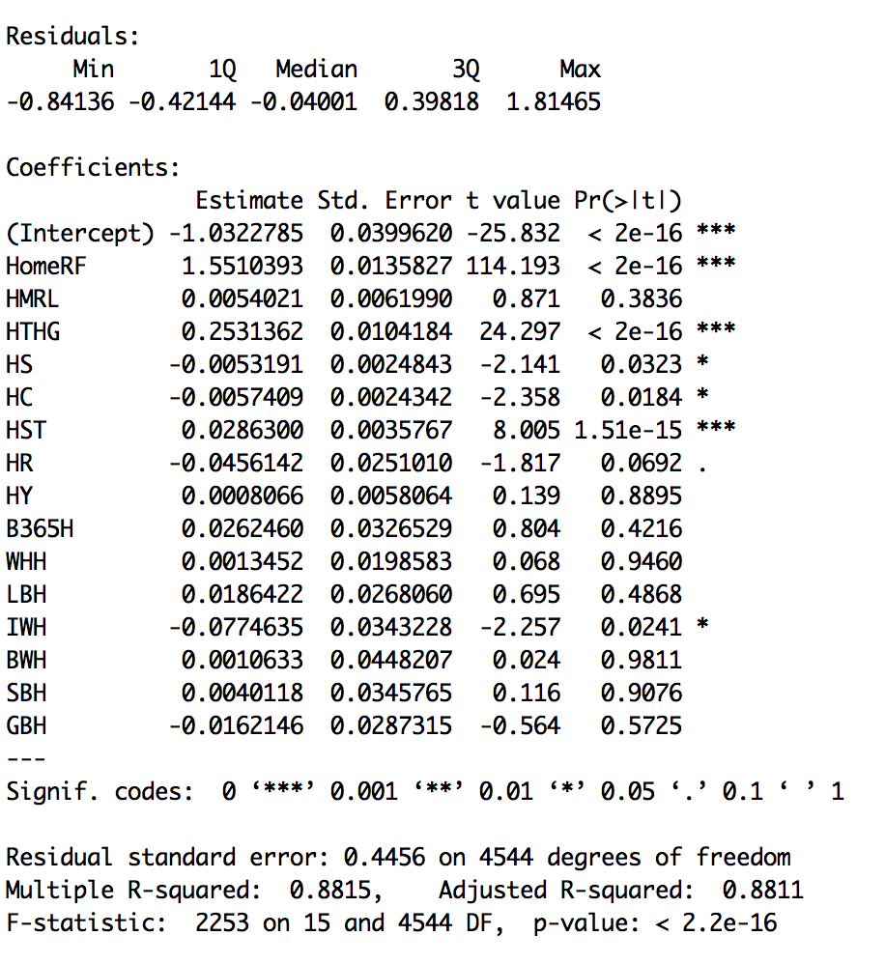
Results – Score Prediction
Linear Regression Analysis to Predict
Scores

Slide 25
What are Betting Odds ?
Chances of a team winning before the match begins.
Example:
Chelsea : 1.23
Draw : 4.33
Wigan : 9.45
The person betting will win 1.23 dollars for his 1 dollar if Chelsea wins and 9.45 dollars if Wigan wins.

Slide 26
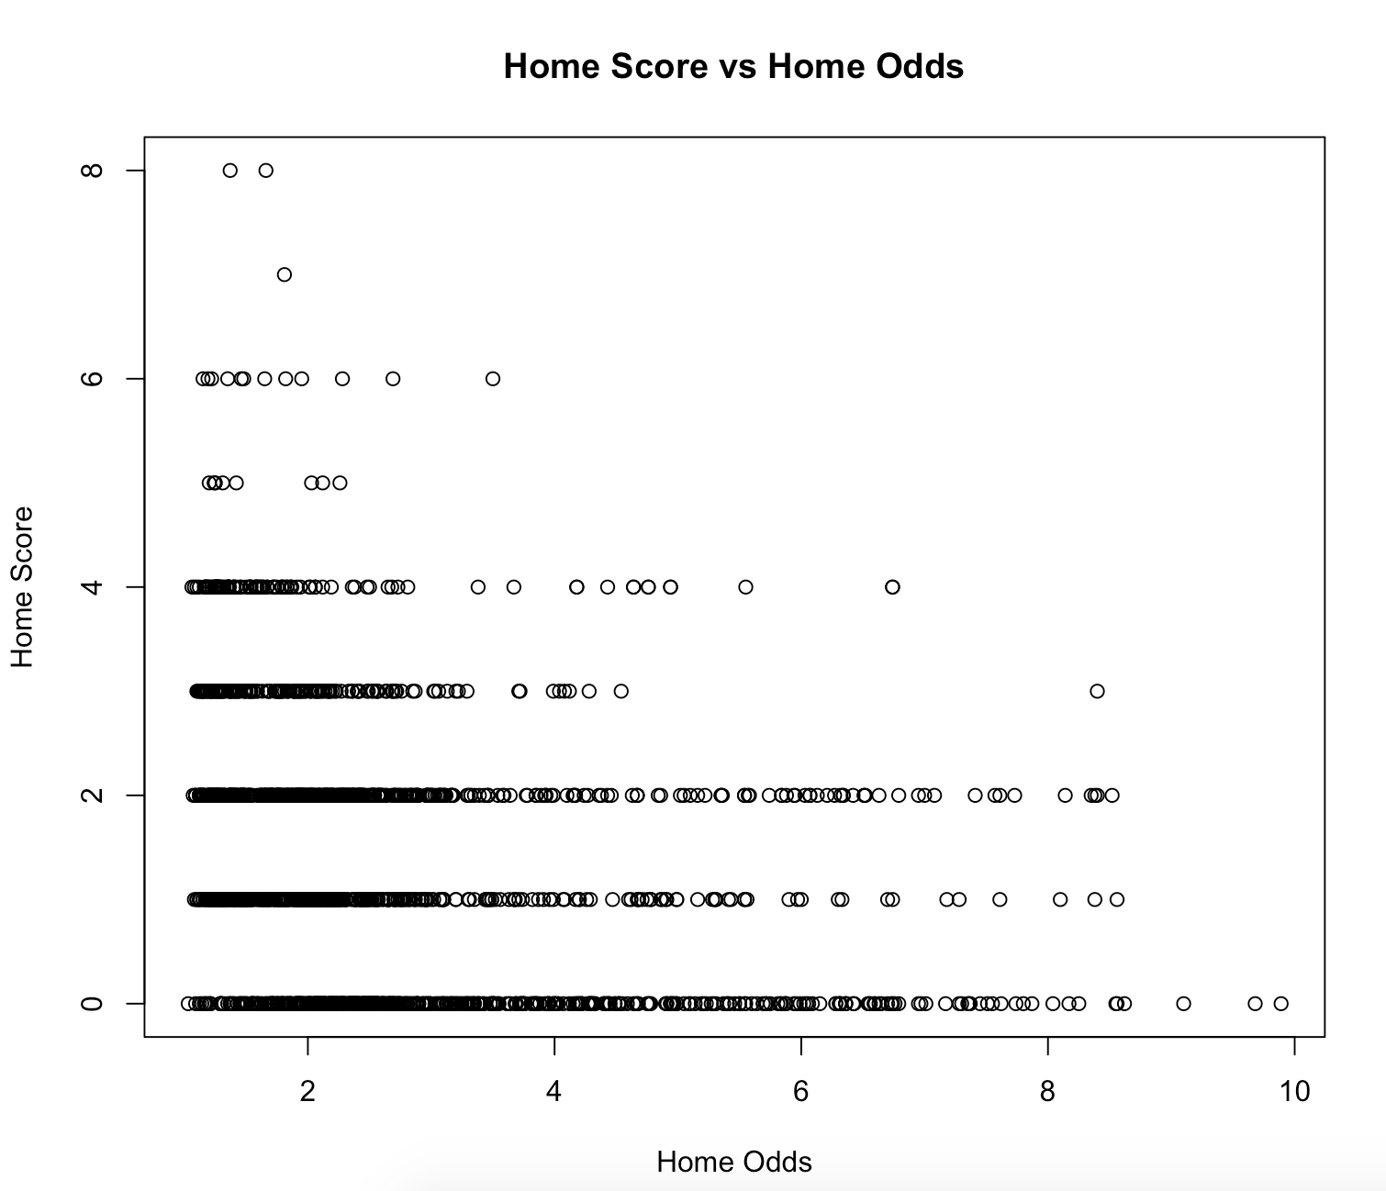
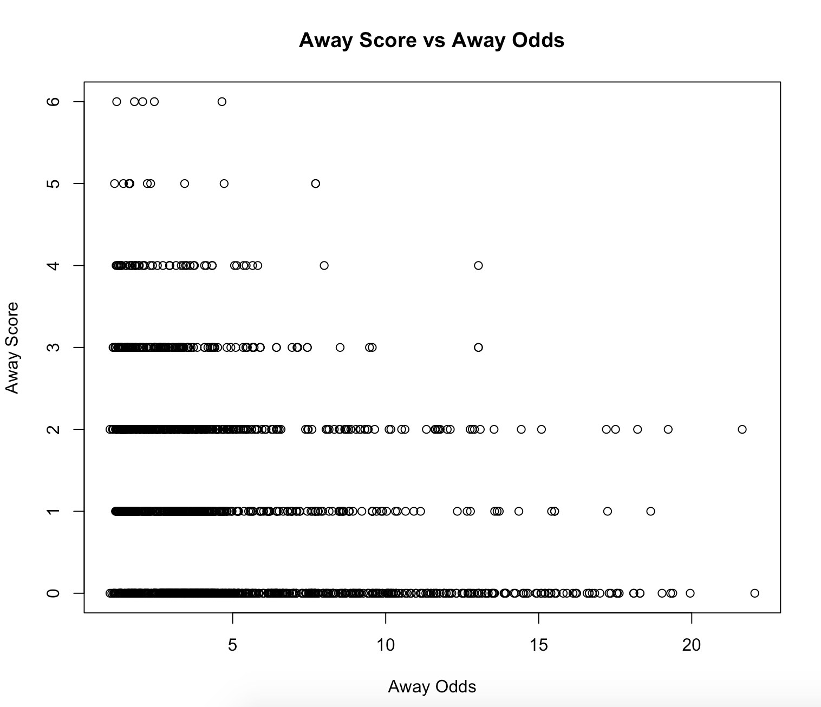
Results – Betting Odds Prediction
Betting Odds Prediction

Slide 27
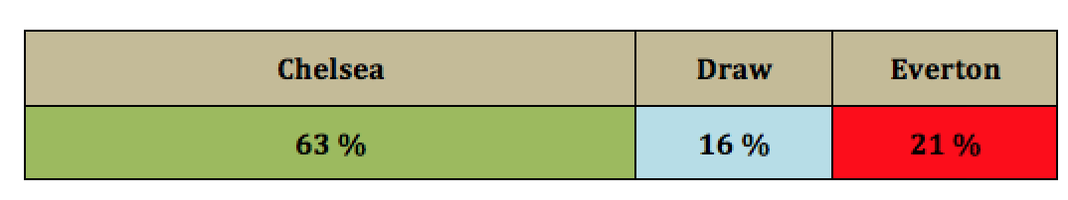
Results – Win Percentage
Poisson Model for predicting Win Percentages probability.
Data Munging followed by dpois function to calculate probability.
Win Percentage Bar for Chelsea vs Everton

Slide 28
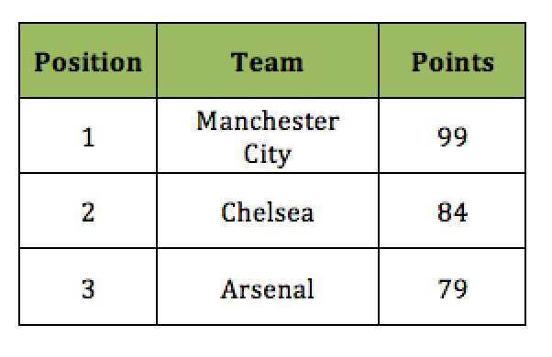
Results – Top 3 Teams
Based on the Analysis and Prediction performed, here are the top 3 teams of the current season:

Slide 29
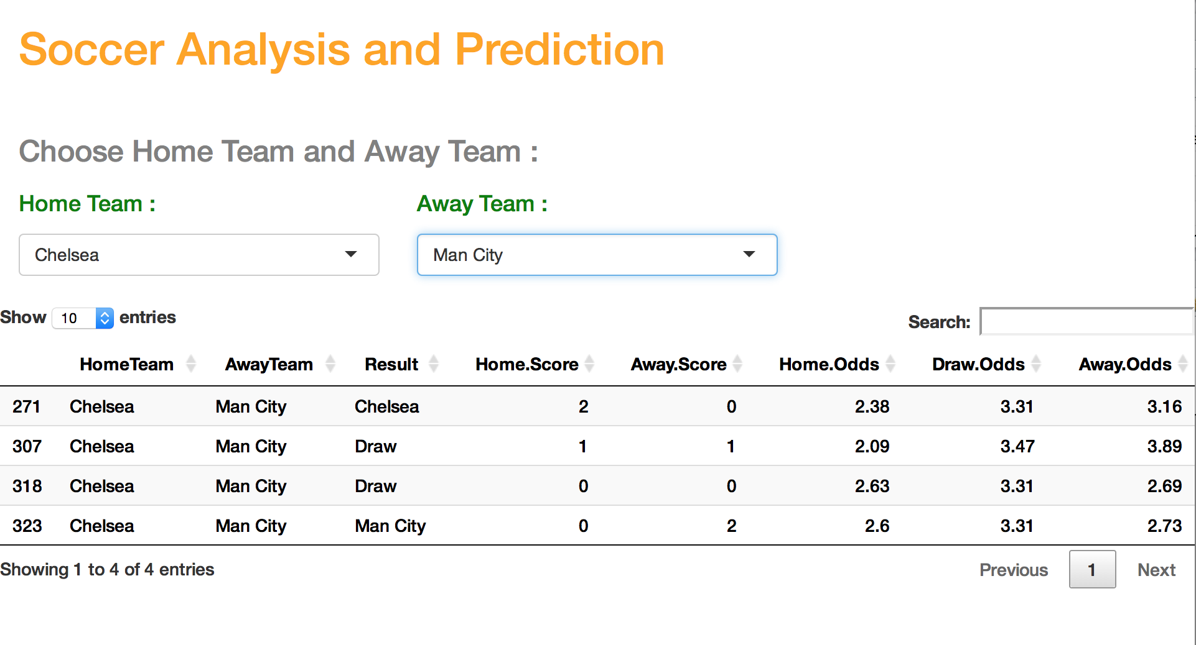
Graphical User Interface
Implemented using the ShinyApps
Displays the predicted results

Slide 30
Next Steps
Extend the functionality of this project to all predict results to different sports.
Take factors such player injury level, climatic condition and player transfers into account.
For win percentage prediction, add the Coles and Dixon adjustment to get more accurate results.

Slide 31
Lessons Learnt
Data Analysis combined with machine learning can be effectively used to predict match outcomes.
Understanding of project domain
Project Management guidelines play an important role.
Advice to future capstone students: Select capstone in domain of interest and try challenging things.

Slide 32
Acknowledgements
Dr. Carol Romanowski for being my mentor guiding me throughout the project.
Professor Peter Boyd for allowing me to complete my Capstone and earn a Masters degree.
Abby Cantwell for being my academic advisor.

Slide 33
References
- M. Haghighat, H. Rastegari, and N. Nourafza. A review of data mining techniques for result prediction in sports. Advances in Computer Science: an International Journal, 2(5):7–12, 2013.
K.-Y. Huang and W.-L. Chang. A neural network method for prediction of 2006 world cup football game. In The 2010 International Joint Conference on Neural Networks (IJCNN), pages 1–8. IEEE, 2010.
F. E. Moya. Statistical methodology for profitable sports gambling. 2012.
M. Ramaswami and R. Bhaskaran. A study on feature selection techniques in educational data mining. arXiv preprint arXiv:0912.3924, 2009.
A. Zimmermann. Wages of wins: could an amateur make money from match outcome predictions?
M. B. Kursa, W. R. Rudnicki, et al. Feature selection with the boruta package.

